Slide 1
Mental Health in the US
By: Brian, Hugo, Mukta
Notes:
BH

Slide 2
Mental Health
Mental illness refers to a wide range of conditions or disorders that affect your mood, thinking and behavior.
Mental illness conditions:
  Depression
  Anxiety
  Schizophrenia
  Eating disorders
  Addictive behaviours
Notes:
BH

Slide 3
Objectives
Study the prevalence of mental health issues in US and compare it with various socio-economic factors.
  Severity of mental health issues and the percentage of the US population that report mental health issues
  Suicide Rates
  Disposable Income
  GDP
  Unemployment
  Poverty
  Presence of medical coverage
Notes:
BH

Slide 4
Data sources
BEA (Bureau of Economic Analysis):
  Personal income
  GDP
CDC (Center for Disease Control and Prevention):
  Suicide rates
US Census Data
  Unemployment
  Poverty status
  Home ownership
  Medical coverage status
Data.gov:
  Severity of mental illness by state
SAMHDA (Substance Abuse and Mental Health Data Archive):
  Mental illness by state
Notes:
BH

Slide 5
Challenges
Data cleaning
Syntax familiarity
Using new libraries
Availability of data
Finding mergeable/comparable data
Using APIs
Interpreting results
Notes:
BH

Slide 6
Interactive map of Mental Health in the US by State
Link
States with the highest severity:
  Oregon
  Alabama
  Kentucky
Notes:
BH

Slide 7
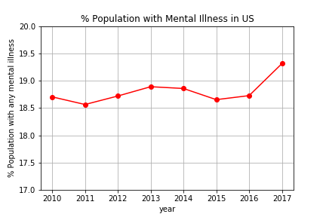
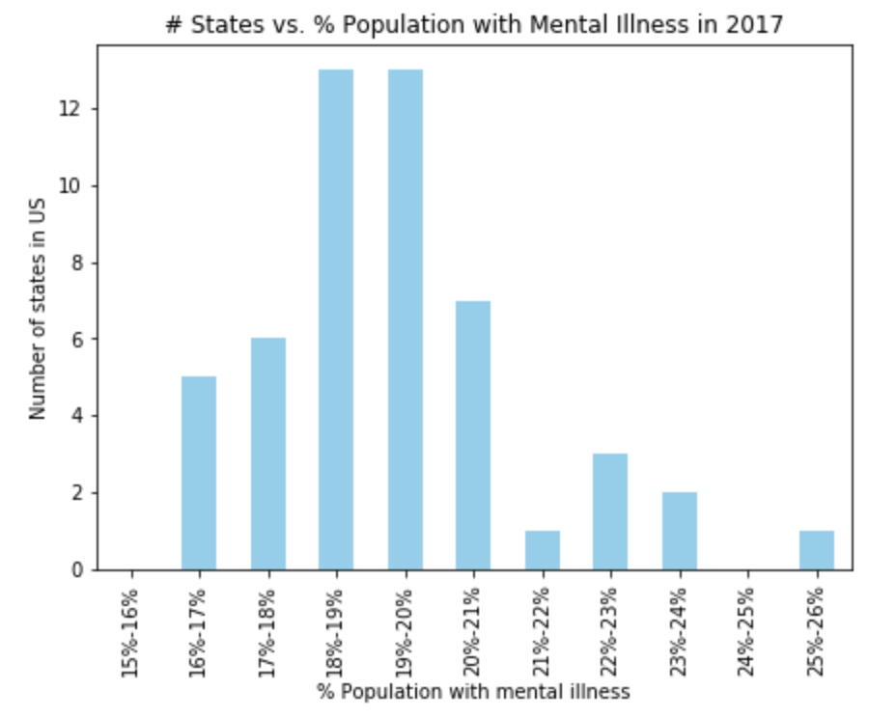
Mental Illness in US
Overall, approx. 1 in 5 adults in US experience mental illness in a year.
Notes:
MJ

Slide 8
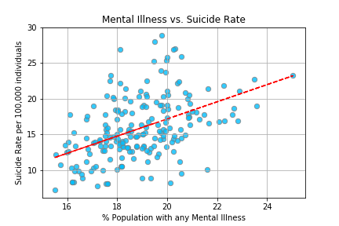
Mental Illness and Suicide Rates
States with higher percentage of population with mental illnesses have higher suicide rates.
Correlation coefficient: 0.46
Notes:
MJ

Slide 9
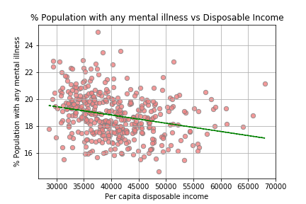
Mental Illness and Income
Weak negative correlation- States with higher income have lower percentage of population with mental illness.
Correlation coefficient:
-0.25
Notes:
MJ

Slide 10
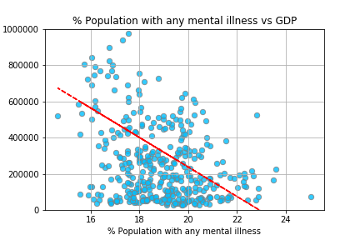
Mental Illness and GDP
Weak negative correlation- States with lower percentage of population with mental illness have higher GDP.
Correlation coefficient:
-0.31
Notes:
MJ

Slide 11
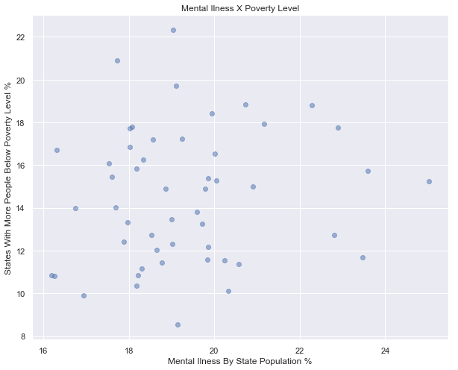
Mental Illness and Poverty
States with greater poverty are NOT [necessarily] states with higher rates of mental illness
Notes:
HA

Slide 12
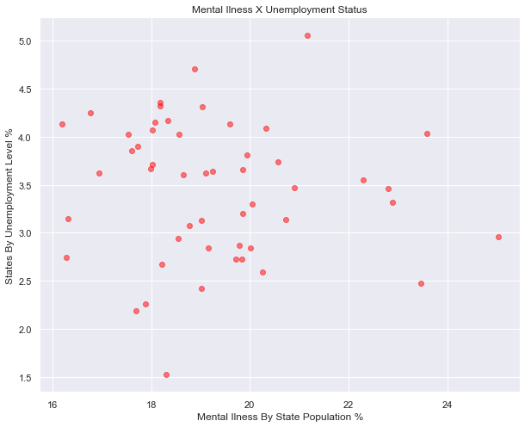
Mental Illness and Employment
States with greater unemployment are NOT [necessarily] states with higher rates of mental illness
Notes:
HA

Slide 13
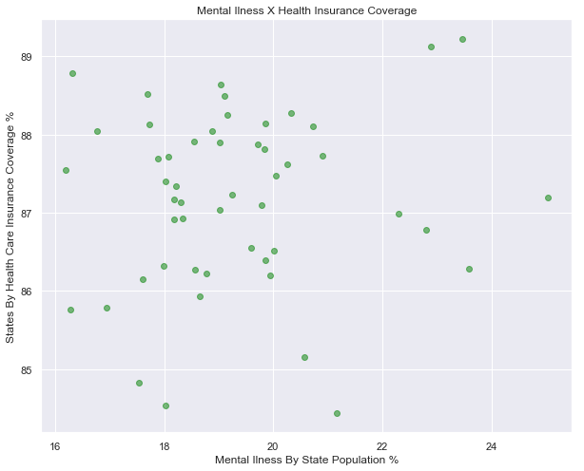
Mental Illness and Health Insurance
States with greater uninsured are NOT [necessarily] states with higher rates of mental illness
Notes:
HA

Slide 14
Next steps
Need too perform more analysis, maybe separate economic and societal factors. Obtaining data for mental illness is also difficult and there isn't much data available.
Compare data at a county level as opposed to the state level for more data points and a more accurate analysis
Compare:
  Suicide rates
  Mental illness
  Variables that may be driving both
Notes:
BH

